Slide 1

7th Grade Math
Unit 12, Lesson 3 Solving Problems Involving Surface Area of Right Circular Cylinders Volume 2, pg. 208

Slide 2


Benchmarks
MA.7.GR.2.1
Given a mathematical or real-world context, find the surface area of a right circular cylinder using the figure’s net.
MA.7.GR.2.2
Solve real-world problems involving surface area of right circular cylinders.
volume 2, pg. 208

Slide 3
Integrated Mathematical Thinking and Reasoning Standards
MA.K12.MTR.1.1 Actively participate in effortful learning both individually and collectively.
MA.K12.MTR.3.1 Complete tasks with mathematical fluency.
MA.K12.MTR.4.1 Engage in discussions that reflect on the mathematical thinking of self and others.
MA.K12.MTR.6.1 Assess the reasonableness of solutions.
MA.K12.MTR.7.1 Apply mathematics to real-world contexts.
volume 2, pg. 208

Slide 4

Learning Targets
I can draw the net of a right circular cylinder.
I can solve problems involving the surface area of a right circular cylinder.
volume 2, pg. 208

Slide 5

Warm-Up
volume 2, pg. 208

Slide 6
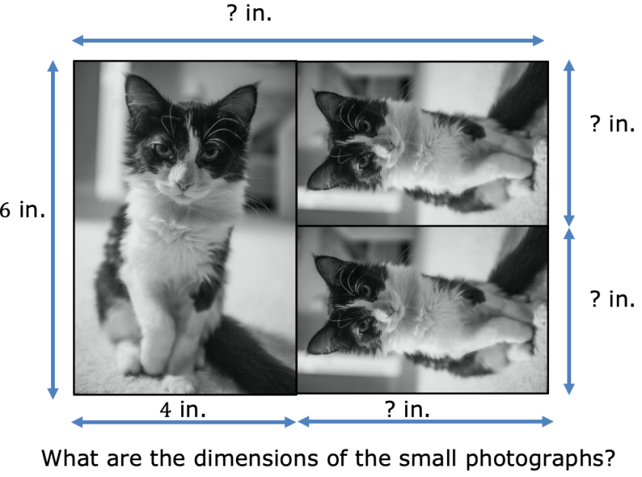
12.3.1 Warm-Up: Photographs
A photographer wants to print a photograph and two smaller copies on the same rectangular sheet of paper. The smaller picture is proportional to the larger picture. Dimensions are given in inches (in.). The diagram is not drawn to scale.
What are the dimensions of the small photographs?
volume 2, pg. 208

Slide 7

Guided Instruction
volume 2, pg. 209

Slide 8
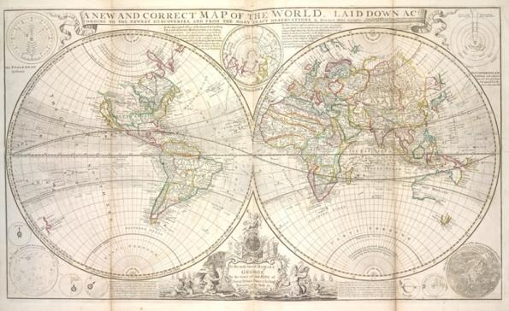
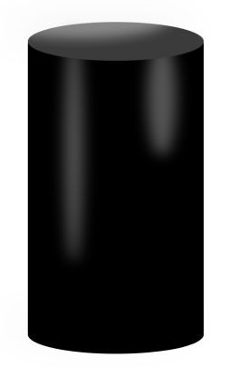
12.3.2 Guided Instruction: Finding the Surface Area of Right Circular Cylinders
For her final art project, Courtney uses an old-
world map to decorate a right-cylindrical pedestal.
She wraps the map around the lateral area
of the pedestal.
Draw a net of the pedestal and label the part of the net where the map will be located.
volume 2, pg. 209

Slide 9
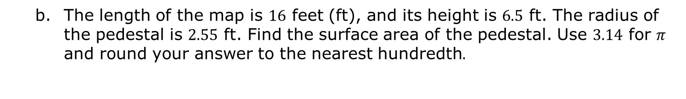
The length of the map is $16$ feet (ft), and its height is $6.5$ ft. The radius of the pedestal is $2.55$ ft. Find the surface area of the pedestal. Use $3.14$ for $π$ and round your answer to the nearest hundredth$.$
volume 2, pg. 209

Slide 10
With your partner, write a formula that could be used to find the surface area of a right circular cylinder.
Ask two classmates to share and explain the formula they wrote. Record their formula in the table. You are the only person who should write in the first column of the table. Have the person verify that you correctly recorded their formula by writing their initials.
Formula | Initials
volume 2, pg. 209

Slide 11
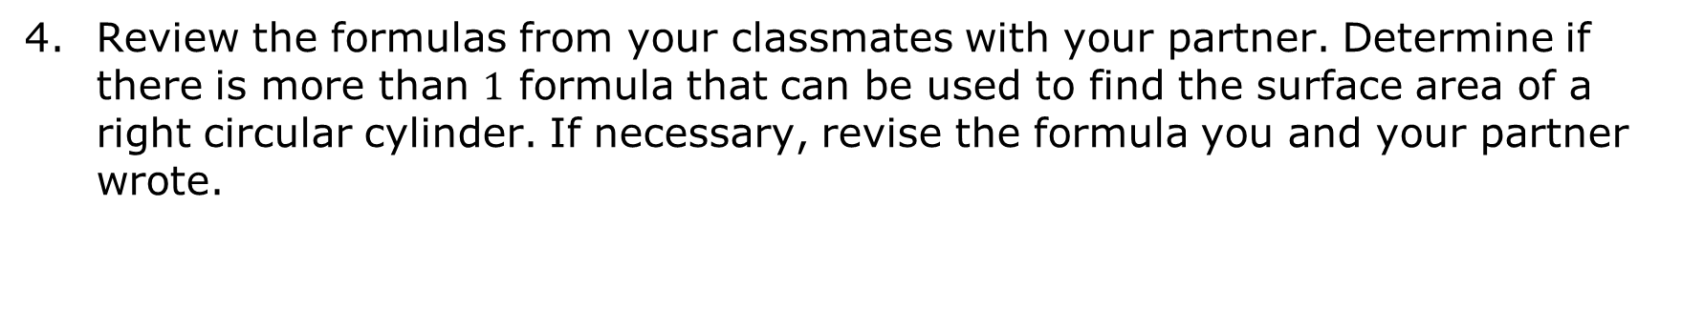
Review the formulas from your classmates with your partner. Determine if there is more than $1$ formula that can be used to find the surface area of a right circular cylinder. If necessary, revise the formula you and your partner wrote.
volume 2, pg. 209

Slide 12

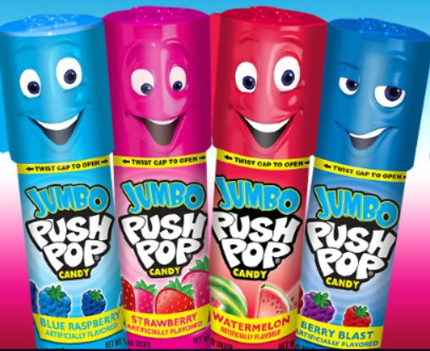
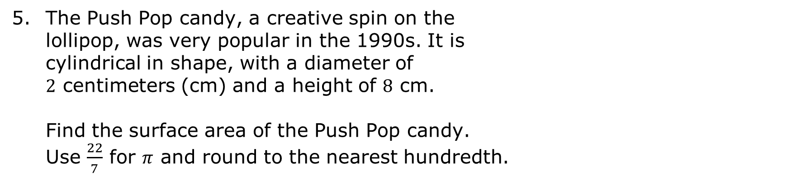
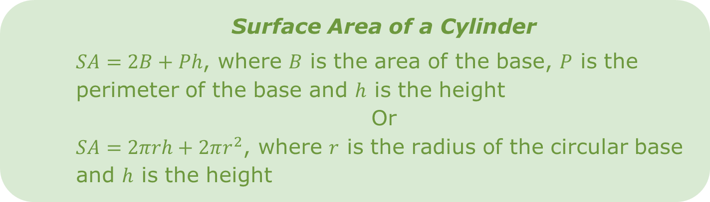
Surface Area of a Cylinder
$SA=2B+Ph$, where $B$ is the area of the base, $P$ is the perimeter of the base and $h$ is the height
Or
$SA=2πrh+2πr^{2}$, where $r$ is the radius of the circular base and $h$ is the height
The Push Pop candy, a creative spin on the
lollipop, was very popular in the 1990s. It is
cylindrical in shape, with a diameter of $2$ centimeters (cm) and a height of $8$ cm.
Find the surface area of the Push Pop candy. Use $\frac{22}{7}$ for $π$ and round to the nearest hundredth.
volume 2, pg. 210

Slide 13

Guided Practice
volume 2, pg. 210

Slide 14

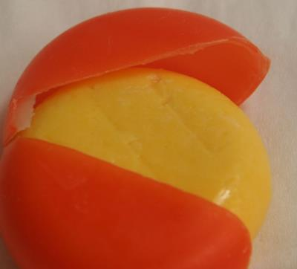
12.3.3 Guided Practice: Solving Problems Involving Surface Area of Right Circular Cylinders
Cheese is often made into a cylindrical shape. Some cheeses are encased in paraffin wax after being formed into a cylindrical shape. The wax specially for
coating cheeses aides in preventing unwanted mold
growth and retains moisture. An example of what the wax coating looks like when removed from around the cheese is shown in the picture.
volume 2, pg. 210

Slide 15
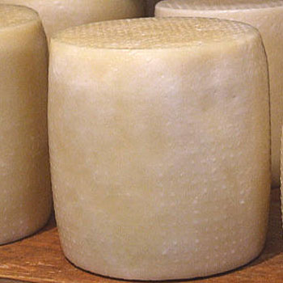

The circumference of a type of Gouda cheese shown is $9.5$ in. and it has a height of $5$ in.
How much wax coating will be needed to encase the cheese? Use $\frac{22}{7}$ for $π$ and round your answer to the nearest hundredth.
volume 2, pg. 210

Slide 16
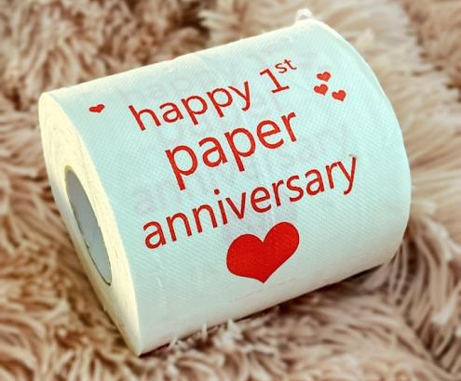
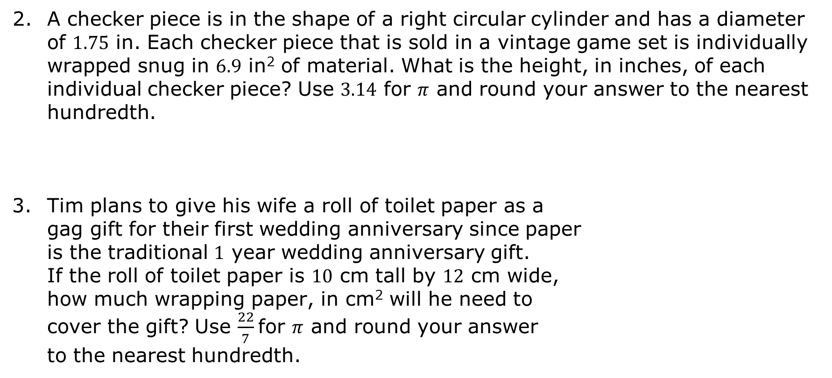
A checker piece is in the shape of a right circular cylinder and has a diameter of $1.75$ in. Each checker piece that is sold in a vintage game set is individually wrapped snug in $6.9$ in² of material. What is the height, in inches, of each individual checker piece? Use $3.14$ for $π$ and round your answer to the nearest hundredth.
Tim plans to give his wife a roll of toilet paper as a gag gift for their first wedding anniversary since paper is the traditional $1$ year wedding anniversary gift. If the roll of toilet paper is $10$ cm tall by $12$ cm wide, how much wrapping paper, in cm² will he need to cover the gift? Use $\frac{22}{7}$ for $π$ and round your answer to the nearest hundredth.
volume 2, pg. 211

Slide 17
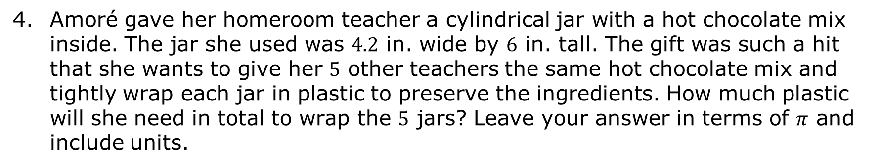
Amoré gave her homeroom teacher a cylindrical jar with a hot chocolate mix inside. The jar she used was $4.2$ in. wide by $6$ in. tall. The gift was such a hit that she wants to give her $5$ other teachers the same hot chocolate mix and tightly wrap each jar in plastic to preserve the ingredients. How much plastic will she need in total to wrap the $5$ jars? Leave your answer in terms of $π$ and include units.
volume 2, pg. 211

Slide 18

Wrap-Up
volume 2, pg. 212

Slide 19
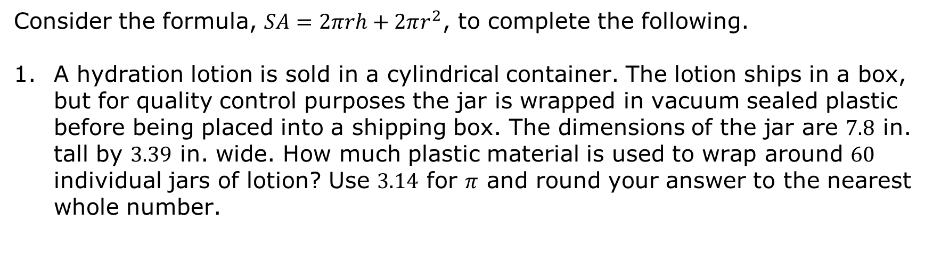
12.3.4 Wrap-Up: Ticket Out the Door
Consider the formula, $SA=2πrh+2πr^{2}$, to complete the following.
A hydration lotion is sold in a cylindrical container. The lotion ships in a box, but for quality control purposes the jar is wrapped in vacuum sealed plastic before being placed into a shipping box. The dimensions of the jar are $7.8$ in. tall by $3.39$ in. wide. How much plastic material is used to wrap around $60$ individual jars of lotion? Use $3.14$ for $π$ and round your answer to the nearest whole number.
volume 2, pg. 212

